Slide 1
Standards for Human Factors!
PSYC 562
University of Idaho

Slide 2
What is a Standard?
Standards are the distilled wisdom of people with expertise in their subject matter and who know the needs of the organizations they represent – people such as manufacturers, sellers, buyers, customers, trade associations, users or regulators. ISO
Examples of Standards? (HF and otherwise)
Why do we have standards? (-ilities)
Life without/before standards? (HF and otherwise)
Hindrances of Standards? Barriers to use?
Domains that could benefit from Standards?
Notes:
Measurement, currency, finance, building codes, food, IT,

Slide 3
Human Factors Standards (non-comprehensive)
MIL-STD-1472 (Military)
NUREG-0700 (Nuclear Power)
FAA 2016-12 (Aviation)
SAE Safety and Human Factors (Auto)
ISO 9241-210:2019 Ergonomics of human-system interaction
FDA Guidance - Applying Human Factors and Usability Engineering to Medical Devices

Slide 4
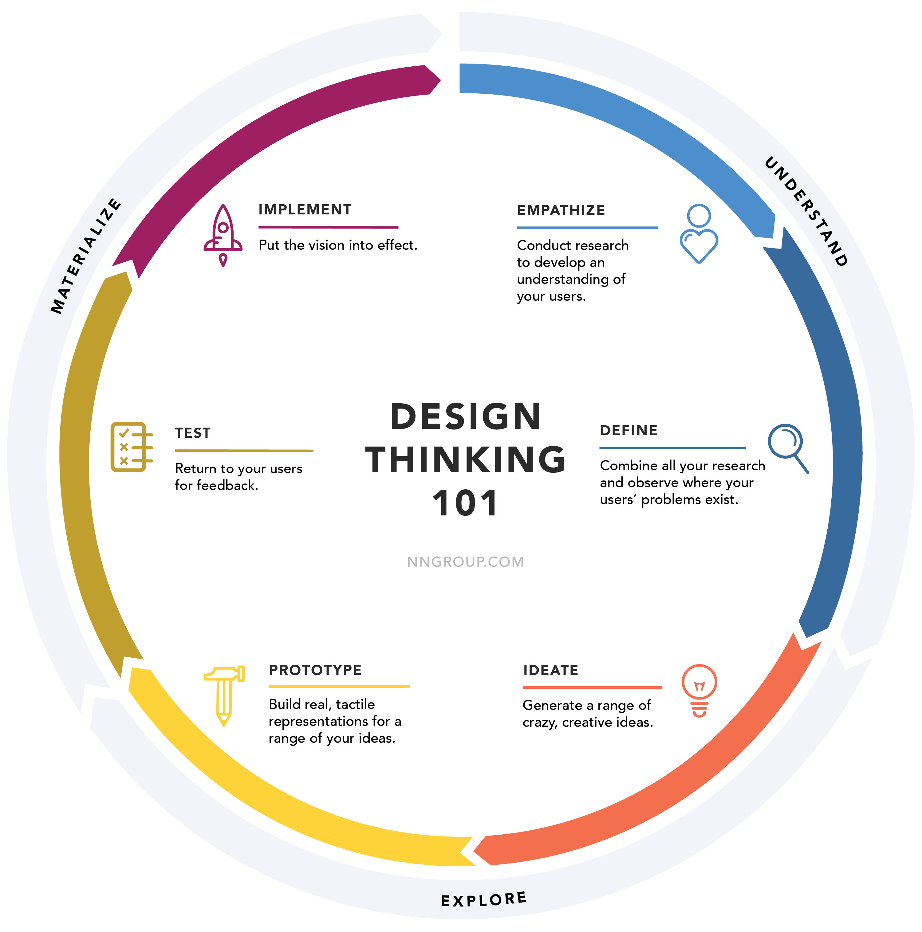
When to Apply Standards Evaluation?
https://www.nngroup.com/articles/design-thinking/

Slide 5
When to Apply Standards Evaluation?
Planning and Analysis
Design
Verification and Validation
Implementation and Operation
Stages of NUREG-0711 Product Review Model

Slide 6
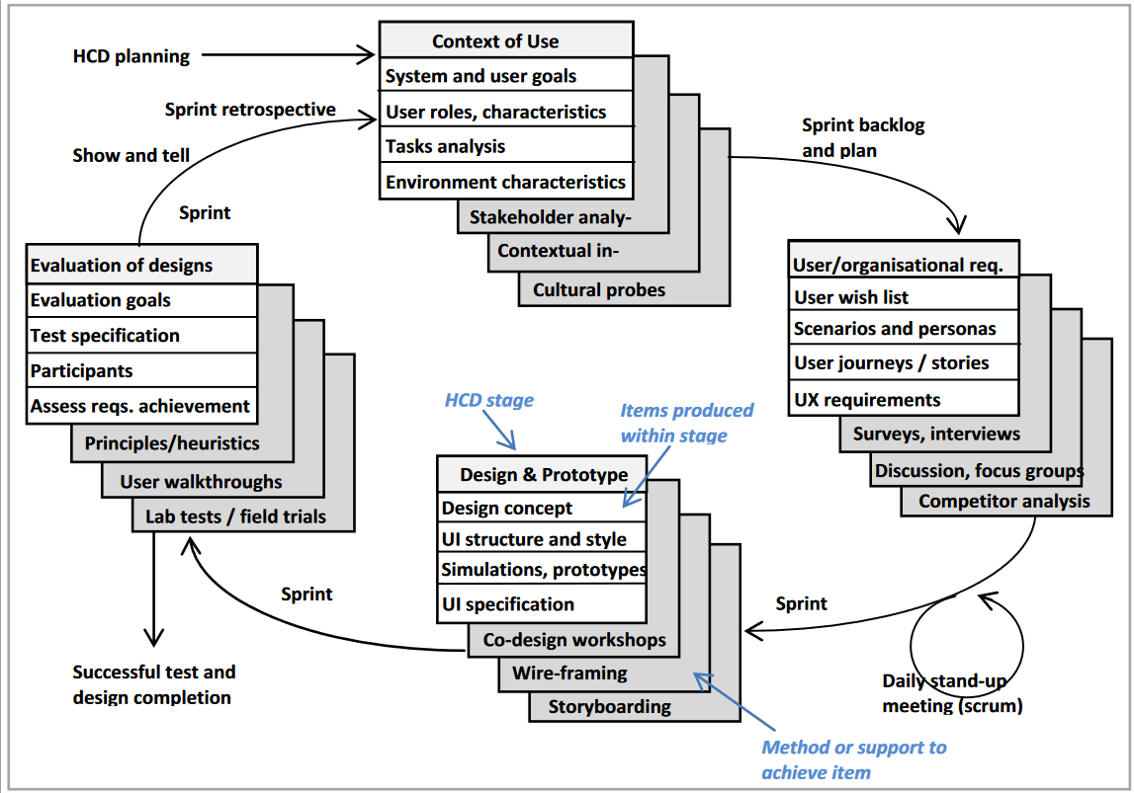
HF Standards to support UX and Agile Design Maguire

Slide 7
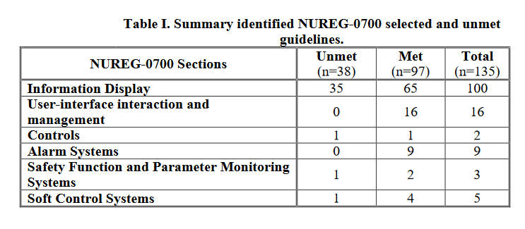
HSI Design Issues in Nuclear Power Kovesdi, Joe

Slide 8
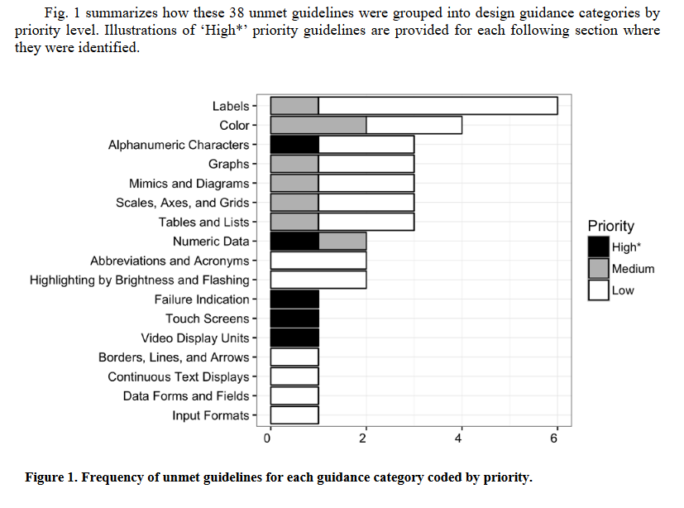

Slide 9
Practitioner vs. Researcher
Is standards evaluation just heuristic evaluation?
Heuristics vs. Empirical Usability Studies
Justifying exceptions to the rules
Practitioner vs. Designer

Slide 10
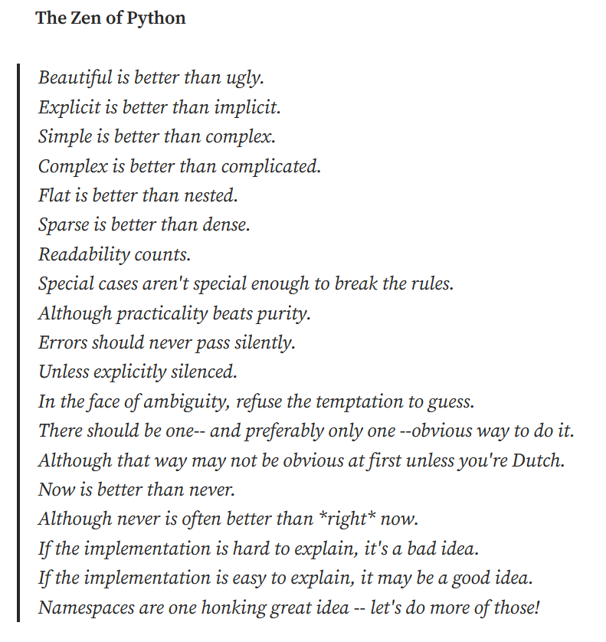
Evaluating and Communicating Standards Evaluations
Context (goals of evaluation)
Selective vs. Comprehensive
Formative vs. Summative
Design guidance vs. licensing vs. certification
Descriptive vs. Pendantic
Risk and liability
Technical Writing
Know your audience
Be concise but explicit
Use active voice
Make it readable
Organization
Rely on pictures

